Slide 1
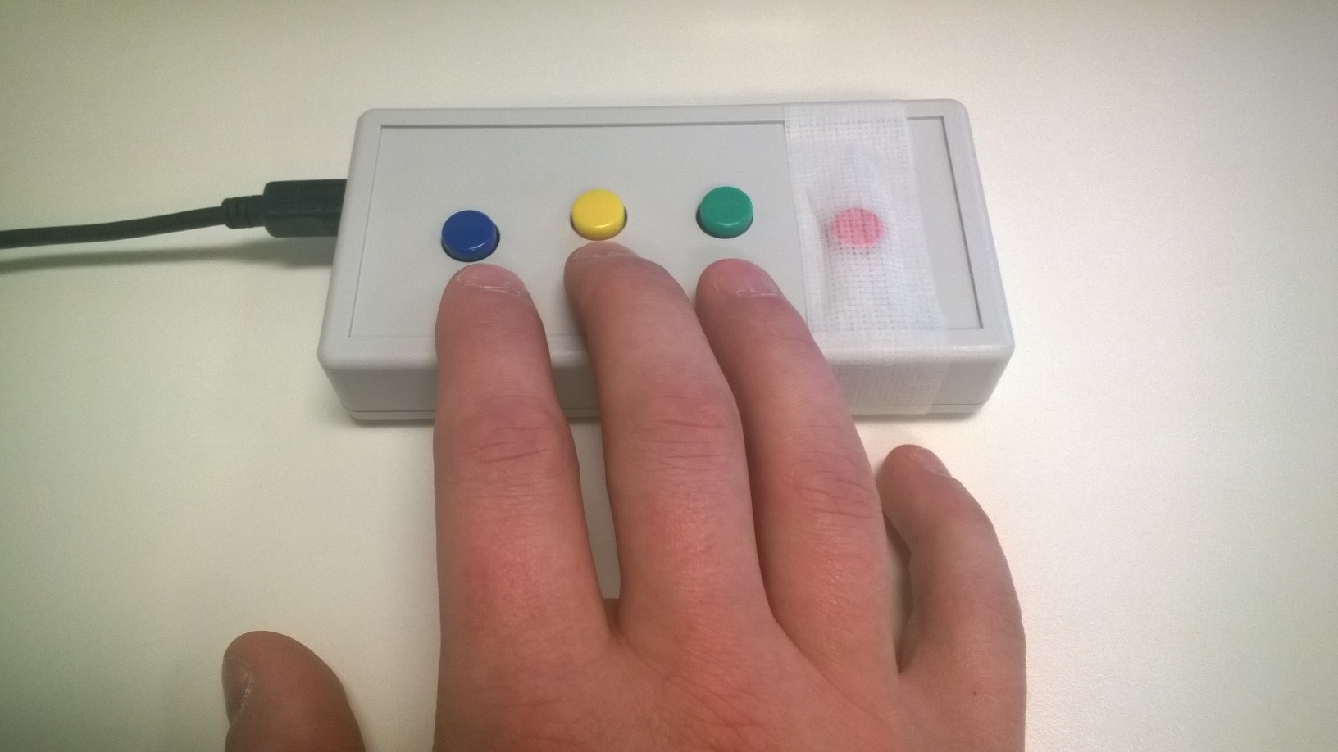
You will be using a button box like the one shown to make responses while you are in the scanner. Place your hand so that you can use your index and middle fingers to press the right and left buttons. Your ring finger will be used at times to select responses.
Please tell the experimenter if you have any questions about how to use the button box.
Left
Right
Select
RIGHT
PRESS THE RIGHT BUTTON TO CONTINUE

Slide 2
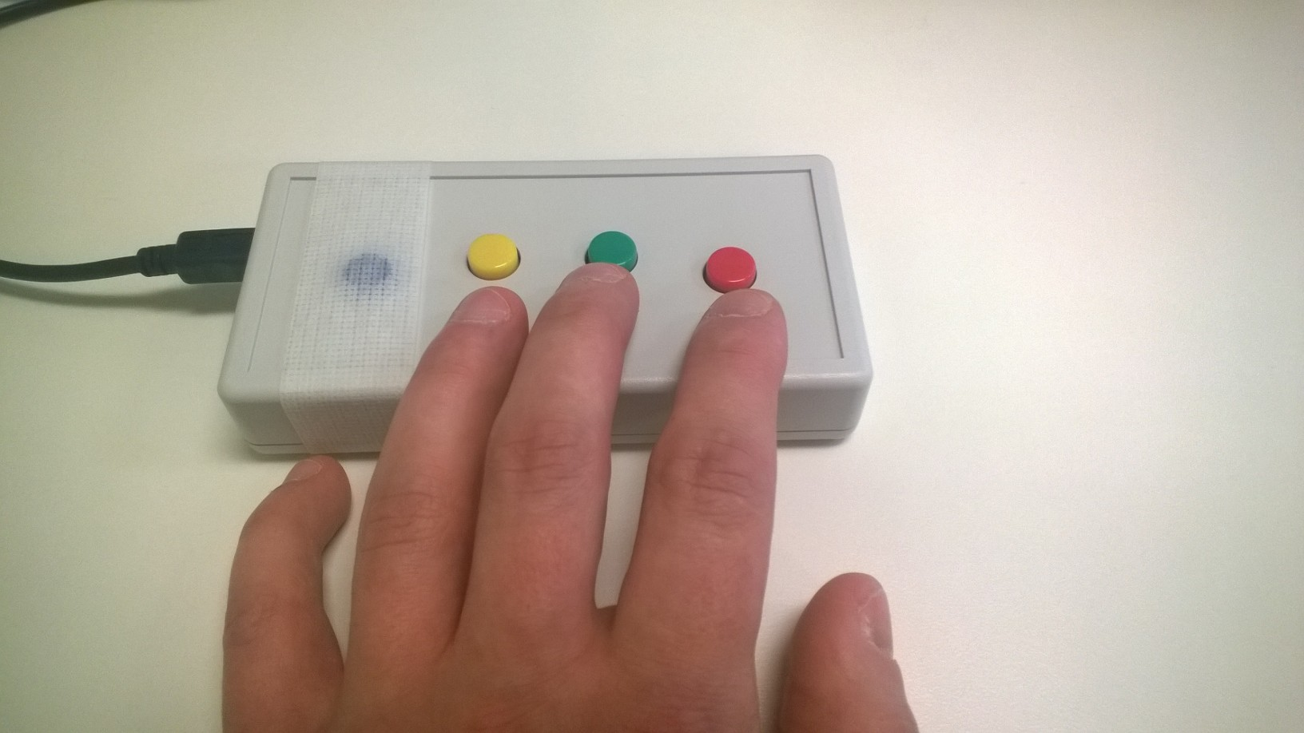
You will be using a button box like the one shown to make responses while you are in the scanner. Place your hand so that you can use your index and middle fingers to press the right and left buttons. Your ring finger will be used at times to select responses.
Please tell the experimenter if you have any questions about how to use the button box.
Left
Select
Right
RIGHT
PRESS THE RIGHT BUTTON TO CONTINUE

Slide 3
Focused Attention
RIGHT
PRESS THE RIGHT BUTTON TO CONTINUE
Notes:
Inside the scanner

Slide 4
This task will have three types of trials:
Attention to the Breath
Attention to the Heartbeat
Attention to a Target word on the screen
Each trial lasts 10 seconds.
LEFT
RIGHT
PRESS THE RIGHT BUTTON TO CONTINUE

Slide 5
When you see “BREATH”: focus your attention onto the sensation of your breath.
When you see “HEARTBEAT”: focus your attention onto the sensation of your heartbeat.
During these trials, do not focus your attention onto anything else except these specific sensations in your body.
LEFT
RIGHT
PRESS THE RIGHT BUTTON TO CONTINUE

Slide 6
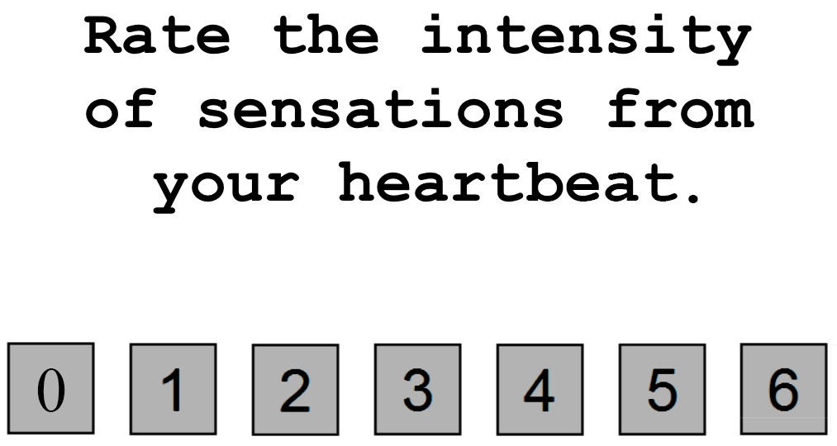

Occasionally, you will be asked to rate on a scale of 0 to 6 your experience. For example, you might see the word “HEARTBEAT” for 10 seconds, during which time you would focus your attention on the sensations of your heartbeat in your chest. Afterward, you might see the screen below
LEFT
RIGHT
PRESS THE RIGHT BUTTON TO CONTINUE
Notes:
NOTE: change rating scale from (1 to 7) to (0 to 6)

Slide 7
You would then use a button box to indicate your rating on the 0-to-6 scale; 0 = no sensation, 3 = moderate sensation, and 6 = extreme sensation.
Use your index and middle fingers to move the arrow, and your ring finger to make a selection.
LEFT
RIGHT
PRESS THE RIGHT BUTTON TO CONTINUE
Notes:
NOTE: also change rating scale from (1 to 7) to (0 to 6)

Slide 8
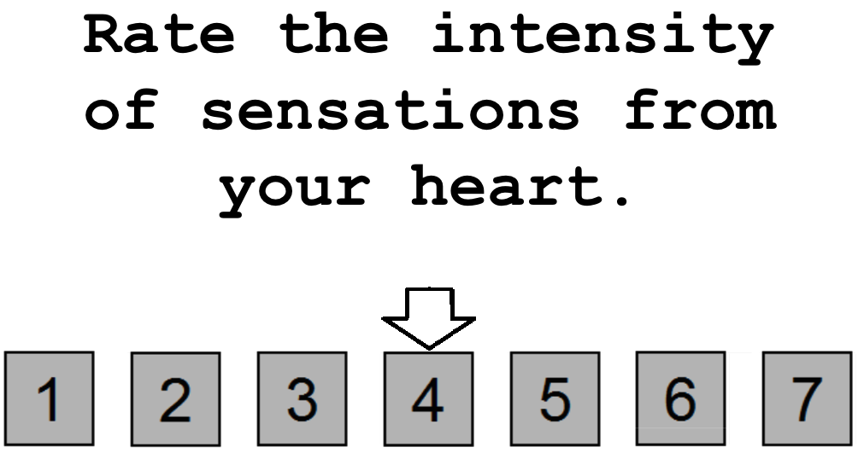
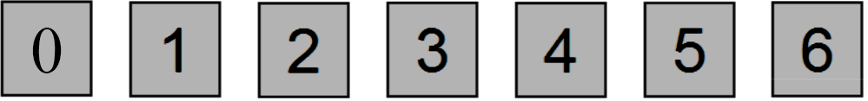
Note that you might be very aware of your heartbeat when it beats quickly, or even slowly. If you were extremely aware of your heartbeat, you would provide a rating of 6. In contrast, if you experienced no sensation at all from your heart during the preceding 10 seconds, you would provide a rating of 0.
You will have 5 seconds to make your response. If you fail to respond in the 5 seconds, don’t worry about it. Just get ready for the next trial.
LEFT
RIGHT
PRESS THE RIGHT BUTTON TO CONTINUE
Notes:
NOTE: also change rating scale from (1 to 7) to (0 to 6)

Slide 9
During the Breath condition, please focus your attention onto all the various body parts where you might feel the sensation of your breath such as in your nose, throat, chest and diaphragm.
In the event of mind-wandering, calmly return your attention back to the breath.
Please do not alter or change your breathing pattern. Just breathe at a normal rate while keeping your eyes open.
LEFT
RIGHT
PRESS THE RIGHT BUTTON TO CONTINUE
Notes:
CHANGE RATE INSTRUCTION BOX: “Rate your awareness of sensations from your heart.” NOTE: also change rating scale from (1 to 7) to (0 to 6)

Slide 10
During the target detection trials, you will see the word “TARGET” appear in the middle of the screen. At fixed intervals, the color of the word “TARGET” will briefly change to a lighter shade of gray. Your job will be to focus your attention on these color changes and notice how intensely the color changes over the ten-second interval. In short, notice how much brighter the word becomes during these color changes. After approximately half of the target detection trials you will make a rating on a scale of 0 to 6 to indicate the intensity of the color change you saw. You will have 5 seconds to make your response. If you fail to respond in the 5 seconds, don’t worry about it. Just get ready for the next trial.
LEFT
RIGHT
PRESS THE RIGHT BUTTON TO CONTINUE

Slide 11

Here is an example of what a target detection trial may look like.
LEFT
Notes:
Add screenshot.

Slide 12

Here is an example of what a target detection trial may look like.
LEFT
Notes:
Add screenshot.

Slide 13
Here is an example of what a target detection trial may look like.
LEFT
Notes:
Add screenshot.

Slide 14
Here is an example of what a target detection trial may look like.
LEFT
RIGHT
PRESS THE RIGHT BUTTON TO CONTINUE
Notes:
Add screenshot.

Slide 15
The time between trials will be variable. Between trials you will see a “+” in the center of the screen. Whenever you see the “+” simply do your best to clear your mind and prepare for the next trial.
LEFT
RIGHT
PRESS THE RIGHT BUTTON TO CONTINUE

Slide 16
Now you will complete a practice run of the Focused Attention Task.
LEFT
RIGHT
PRESS THE RIGHT BUTTON TO CONTINUE

Slide 17
Press the RIGHT button when you are ready to begin
LEFT
RIGHT
PRESS THE RIGHT BUTTON TO CONTINUE
Notes:
Inside the scanner

Slide 18
Focused Attention
PRESS THE RIGHT BUTTON TO CONTINUE
Notes:
Inside the scanner

Slide 19
Now you will complete the Focused Attention Task.
Remember, when you see the words HEARTBEAT or BREATH, focus your attention onto feeling those sensations in your body.
When you see the word TARGET, focus your attention on how intensely it changes colors
PRESS THE RIGHT BUTTON TO CONTINUE

Slide 20
When you are asked to make a rating, use your index, middle, and ring fingers to rate the intensity of the sensations you felt or the intensity of the color change.
Left
Right
Select
PRESS THE RIGHT BUTTON TO CONTINUE

Slide 21
When you are asked to make a rating, use your index, middle, and ring fingers to rate the intensity of the sensations you felt or the intensity of the color change.
Select
Left
Right
PRESS THE RIGHT BUTTON TO CONTINUE

Slide 22
Press the RIGHT button when you are ready to begin
PRESS THE RIGHT BUTTON TO CONTINUE
Notes:
Inside the scanner

Slide 23
Focused Attention
PRESS THE RIGHT BUTTON TO CONTINUE
Notes:
Inside the scanner

Slide 24
Now you will complete another run of the Focused Attention task.
PRESS THE RIGHT BUTTON TO CONTINUE

Slide 25
Press the RIGHT button when you are ready to begin
PRESS THE RIGHT BUTTON TO CONTINUE
Notes:
Inside the scanner

Slide 26
Rest
PRESS THE RIGHT BUTTON TO CONTINUE
Notes:
Inside the scanner

Slide 27
For this scan, close your eyes, clear your mind, and try not to think about anything in particular.
Please do NOT fall asleep.
you will see a “+” in the center of the screen.
Focus on the “+”, clear your mind and try not to think of anything in particular.
PRESS THE RIGHT BUTTON TO CONTINUE
Notes:
For inside the scanner.
What happens when they press enter?

Slide 28
Press the RIGHT button when you are ready to begin
PRESS THE RIGHT BUTTON TO CONTINUE
Notes:
Inside the scanner

Slide 29
Press the RIGHT button when you are ready to begin
This is run 1 of 10
PRESS THE RIGHT BUTTON TO CONTINUE
Notes:
Inside the scanner

Slide 30
Press the RIGHT button when you are ready to begin
This is run 2 of 10
PRESS THE RIGHT BUTTON TO CONTINUE
Notes:
Inside the scanner

Slide 31
Press the RIGHT button when you are ready to begin
This is run 3 of 10
PRESS THE RIGHT BUTTON TO CONTINUE
Notes:
Inside the scanner

Slide 32
Press the RIGHT button when you are ready to begin
This is run 4 of 10
PRESS THE RIGHT BUTTON TO CONTINUE
Notes:
Inside the scanner

Slide 33
Press the RIGHT button when you are ready to begin
This is run 5 of 10
PRESS THE RIGHT BUTTON TO CONTINUE
Notes:
Inside the scanner

Slide 34
Press the RIGHT button when you are ready to begin
This is run 6 of 10
PRESS THE RIGHT BUTTON TO CONTINUE
Notes:
Inside the scanner

Slide 35
Press the RIGHT button when you are ready to begin
This is run 7 of 10
PRESS THE RIGHT BUTTON TO CONTINUE
Notes:
Inside the scanner

Slide 36
Press the RIGHT button when you are ready to begin
This is run 8 of 10
PRESS THE RIGHT BUTTON TO CONTINUE
Notes:
Inside the scanner

Slide 37
Press the RIGHT button when you are ready to begin
This is run 9 of 10
PRESS THE RIGHT BUTTON TO CONTINUE
Notes:
Inside the scanner

Slide 38
Press the RIGHT button when you are ready to begin
This is run 10 of 10
PRESS THE RIGHT BUTTON TO CONTINUE
Notes:
Inside the scanner

Slide 39
Shapes and Faces
PRESS THE RIGHT BUTTON TO CONTINUE
Notes:
Inside the scanner

Slide 40
In this task, you will see sets of three images arranged in a triangle and your job is to decide which of the bottom two images matches the top one. Press the left or right button to make your selection as soon as you decide.
Left
Right
PRESS THE RIGHT BUTTON TO CONTINUE

Slide 41
In this task, you will see sets of three images arranged in a triangle and your job is to decide which of the bottom two images matches the top one. Press the left or right button to make your selection as soon as you decide.
Left
Right
PRESS THE RIGHT BUTTON TO CONTINUE

Slide 42

There are two conditions: shapes and faces. In the shapes condition, just pick the shape that matches the top one. For example, if you saw the screen below you would press the RIGHT button
Target
Match
No Match
PRESS THE RIGHT BUTTON TO CONTINUE

Slide 43
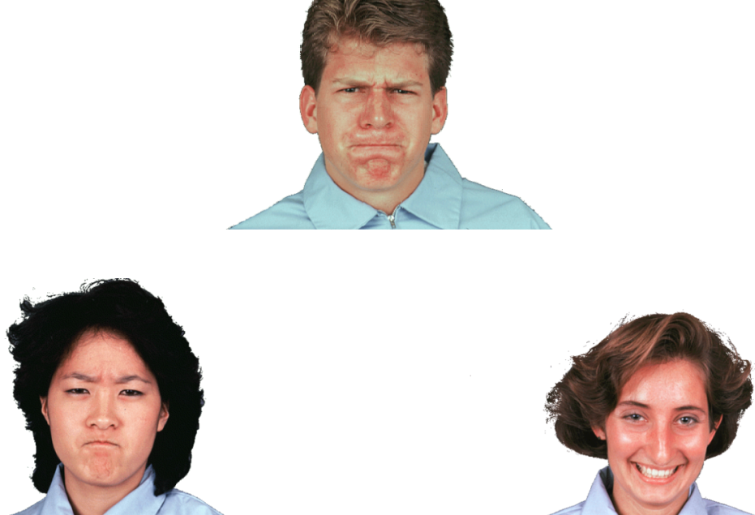
In the faces condition, pick the person showing the same emotion as the target.
Target
No Match
Match
PRESS THE RIGHT BUTTON TO CONTINUE

Slide 44
You will be reminded of the instructions by seeing the words “Match form” and “Match emotion” before blocks of shape or face trials.
PRESS THE RIGHT BUTTON TO CONTINUE

Slide 45
Press the RIGHT button when you are ready to begin
PRESS THE RIGHT BUTTON TO CONTINUE
Notes:
Inside the scanner

Slide 46
Shapes and Faces
PRESS THE RIGHT BUTTON TO CONTINUE
Notes:
Inside the scanner

Slide 47
Now you will complete the shapes and faces task. Remember, your job is to pick the bottom image that matches either the shape or the emotion of the top one.
Left
Right
PRESS THE RIGHT BUTTON TO CONTINUE

Slide 48
Now you will complete the shapes and faces task. Remember, your job is to pick the bottom image that matches either the shape or the emotion of the top one.
Left
Right
PRESS THE RIGHT BUTTON TO CONTINUE

Slide 49
For example, if you saw the screen below, you would press the RIGHT button.
Target
Match
No Match
PRESS THE RIGHT BUTTON TO CONTINUE

Slide 50
Press the RIGHT button when you are ready to begin
PRESS THE RIGHT BUTTON TO CONTINUE
Notes:
Inside the scanner

Slide 51
Press the RIGHT button when you are ready to begin
This is run 1 of 7
PRESS THE RIGHT BUTTON TO CONTINUE
Notes:
Inside the scanner

Slide 52
Press the RIGHT button when you are ready to begin
This is run 2 of 7
PRESS THE RIGHT BUTTON TO CONTINUE
Notes:
Inside the scanner

Slide 53
Press the RIGHT button when you are ready to begin
This is run 3 of 7
PRESS THE RIGHT BUTTON TO CONTINUE
Notes:
Inside the scanner

Slide 54
Press the RIGHT button when you are ready to begin
This is run 4 of 7
PRESS THE RIGHT BUTTON TO CONTINUE
Notes:
Inside the scanner

Slide 55
Press the RIGHT button when you are ready to begin
This is run 5 of 7
PRESS THE RIGHT BUTTON TO CONTINUE
Notes:
Inside the scanner

Slide 56
Press the RIGHT button when you are ready to begin
This is run 6 of 7
PRESS THE RIGHT BUTTON TO CONTINUE
Notes:
Inside the scanner

Slide 57
Press the RIGHT button when you are ready to begin
This is run 7 of 7
PRESS THE RIGHT BUTTON TO CONTINUE
Notes:
Inside the scanner

